Slide 1


Leading the Club To Success (Club Success Plan)
Pre-meeting Handout
Club Officer Training Division Delightful
August 1, 2020
Area 43 Director, Seiko Matsumoto

Slide 2
2. Requirements for Success Distinguished Club Program (DCP) By TM Inoue
Four Level 1 awards achieved
Two Level 2 awards achieved
Two more Level 2 awards achieved
Two Level 3 awards achieved
One Level 4, Level 5, or DTM award achieved
One more Level 4, Level 5, or DTM award achieved
EDUCATION
10 / 10 points
President’s Distinguished Club
Four new members
Four more new members
MEMBERSHIP
9 points
Select Distinguished Club
TRAINING
A minimum of four club officers trained during each of the two training periods (Jun-Aug, Nov-Feb)
7 points
ADMINIS
TRATION
(1) On-time payment of membership dues accompanied by the names of eight members (at least 3 of whom must be renewing members) (2) For one period and on-time submission of one club officer list
Distinguished Club
5 points
DCP point structure
Notes:
2 mins
Here is the measurement on your achievement as a club, called DCP
I like to stress that this is not the only one goal for your success
As Tanaka-san said, the club satisfaction is the most important
You don’t need to remember all of these elements

Slide 3
1-1 Action Plan for Success (Education)
Situation Analysis & Goal Setting
Item | ２０１９－２０２０ | ２０２０－２０２１
DCP
Obstacles １
Motivation
Familiarity of members
Promotion

Slide 4
1-2 Action Plan for Success (Membership)
Situation Analysis & Goal Setting
Item | ２０１９－２０２０ | ２０２０－２０２１
DCP
Obstacles １
Motivation
Familiarity of members
Promotion

Slide 5
1-3 Action Plan for Success (Training)
Situation Analysis & Goal Setting
Item | ２０１９－２０２０ | ２０２０－２０２１
DCP
Obstacles １
Motivation
Familiarity of members
Promotion

Slide 6
1-4 Action Plan for Success (Administration)
Situation Analysis & Goal Setting
Item | ２０１９－２０２０ | ２０２０－２０２１
DCP
Obstacles １
Motivation
Familiarity of members
Promotion

Slide 7
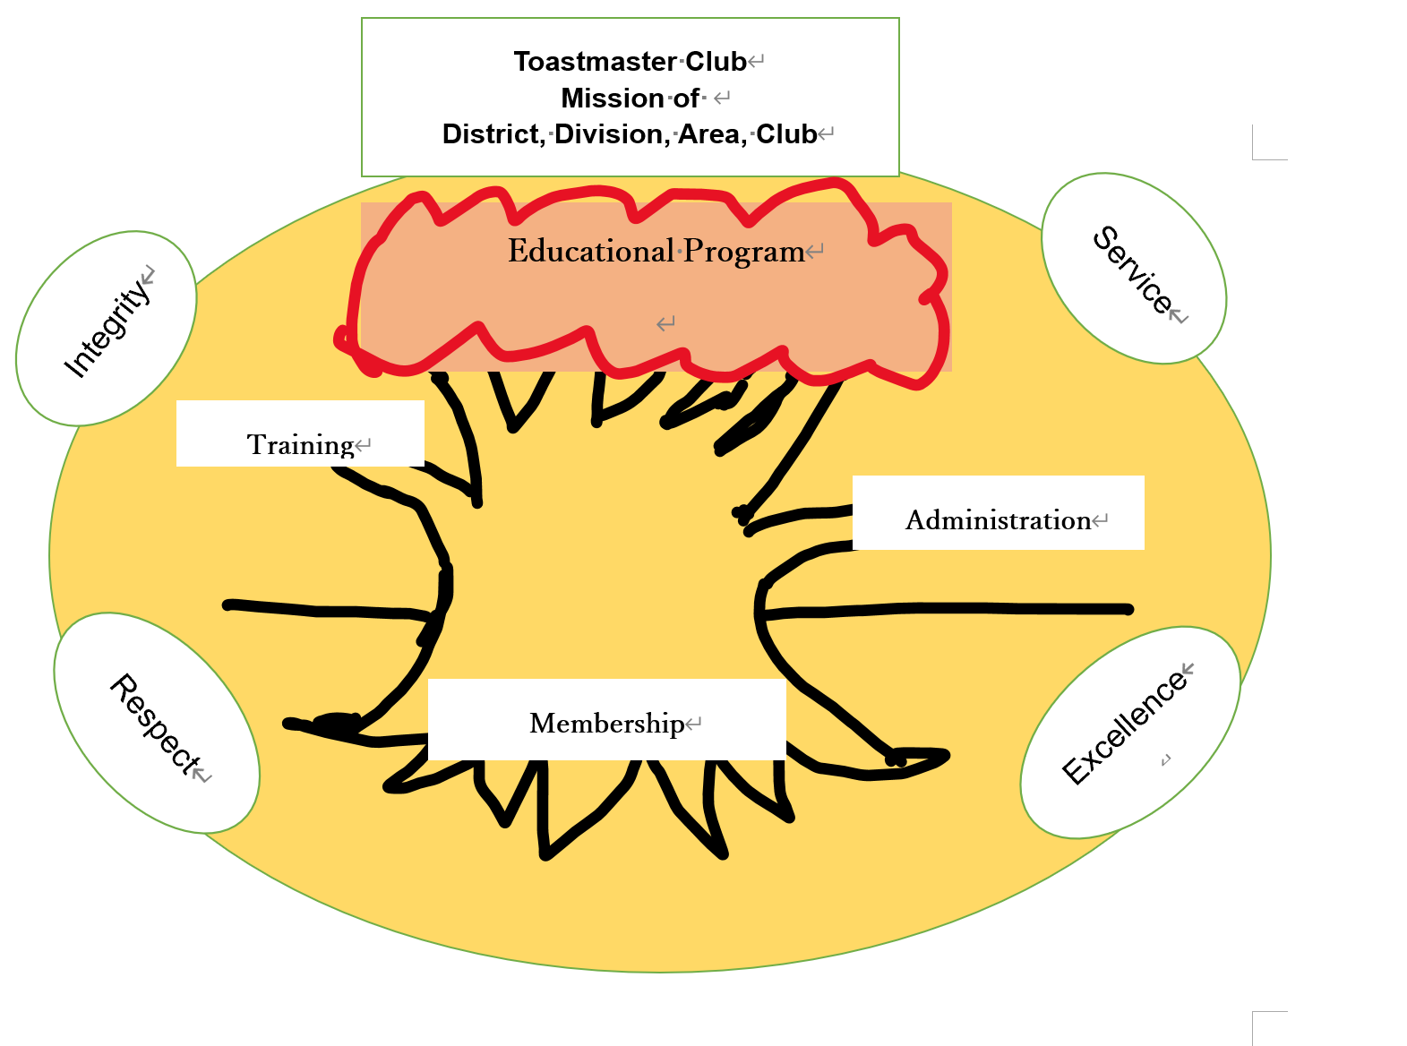
Success Tree

